Slide 1


Dr. D. Y. Patil Pratishthan's Institute for Advanced Computing and Software Development
DAY 2 C Programming

Slide 2
Day2
Today We discuss the following topics:-
--Why not English Why C ?
--History Of C
--English Vs Programming Language
--Built in Words(Keywords)
--User defined words(Identifiers)
--Variables
--Data Types
--Constant
--Operators
--Format Specifiers
--Console I/O functions
--Simple C program
--Escape Sequences
--Precendance,Associativity and Arity
--Type Casting

Slide 3
Why not English why C?
Natural Language are ambiguous by nature.
--Bank-a financial institution or an edge of a river.
--Good-can mean useful or pleasing
Programming language are distinct and clear
Each word in a programming language has one & only one meaning. No two words mean the same.

Slide 4

History Of C
C programming language was developed in 1972 by Dennis Ritchie at bell laboratories of AT&T (American Telephone & Telegraph), located in the U.S.A.
Dennis Ritchie is known as the founder of the c language.
It was developed to overcome the problems of previous languages such as B, BCPL, etc.
Initially, C language was developed to be used in UNIX operating system. It inherits many features of previous languages such as B and BCPL

Slide 5
Before C Language:-
Language | Year | Developed By
Algol | 1960 | International Group
BCPL | 1967 | Martin Richard
B | 1970 | Ken Thompson
Traditional C | 1972 | Dennis Ritchie
K & R C | 1978 | Kernighan & Dennis Ritchie
ANSI C | 1989 | ANSI Committee
ANSI/ISO C | 1990 | ISO Committee
C99 | 1999 | Standardization Committee

Slide 6
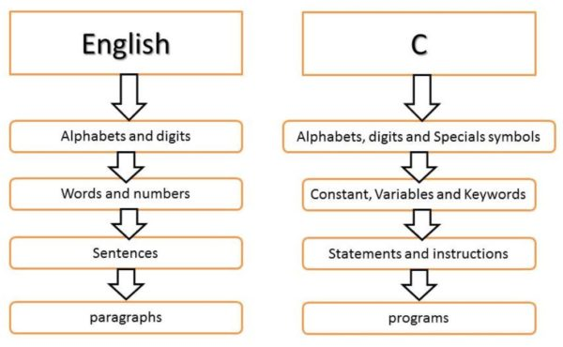
English Vs C

Slide 7
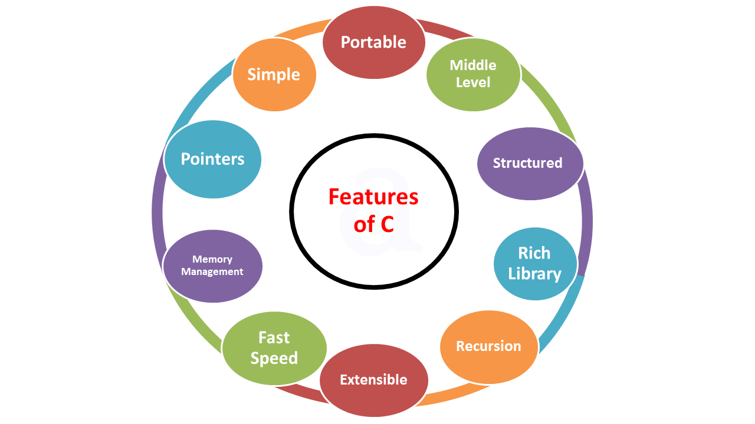
Features Of C:-

Slide 8
C Tokens
Keyword
Identifiers
Variables
Data Types
Character set
Constant
Operators

Slide 9
Keywords in C
A keyword is a reserved word. You cannot use it as a variable name, constant name, etc. There are only 32 reserved words (keywords) in the C language.
A list of 32 keywords in the c language is given below:
auto | break | case | char | const | continue | default | do
double | else | enum | extern | float | for | goto | if
int | long | register | return | short | signed | sizeof | static
struct | switch | typedef | union | unsigned | void | volatile | while

Slide 10
C Identifiers
C identifiers represent the name in the C program, for example, variables, functions, arrays, structures, unions, labels, etc. An identifier can be composed of letters such as uppercase, lowercase letters, underscore, digits, but the starting letter should be either an alphabet or an underscore

Slide 11
Rules for constructing C identifiers:-
The first character of an identifier should be either an alphabet or an underscore, and then it can be followed by any of the character, digit, or underscore. E.g.num1,_num1,NUM1,Num1
It should not begin with any numerical digit.
In identifiers, both uppercase and lowercase letters are distinct. Therefore, we can say that identifiers are case sensitive.
Commas or blank spaces cannot be specified within an identifier.
Keywords cannot be represented as an identifier.
The length of the identifiers should not be more than 31 characters.
Identifiers should be written in such a way that it is meaningful, short, and easy to read.

Slide 12
Variables in C
A variable is a name of the memory location. It is used to store data. Its value can be changed, and it can be reused many times.
It is a way to represent memory location through symbol so that it can be easily identified.
Let's see the syntax to declare a variable:
type variable_list;
10+20
Num1=10
Num2=20
int a=10,b=20;//declaring 2 variable of integer type
float f=20.8;
char c='A'

Slide 13
Rules for defining variables
Must be declared first use.
A variable can have alphabets, digits, and underscore.
A variable name can start with the alphabet, and underscore only. It can't start with a digit.
No whitespace is allowed within the variable name.
A variable name must not be any reserved word or keyword, e.g. int, float, etc.
For local variables ,declaration statements must be placed at the beginning of the block
For global variables, declaration statements must be placed before first function definition.

Slide 14
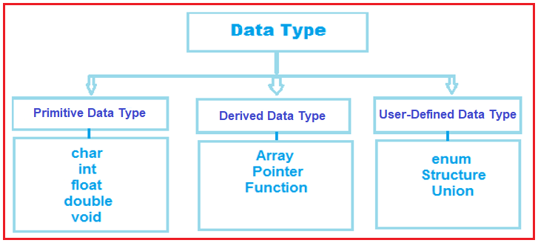
Data Types in C:-

Slide 15
Data Types in C
Each variable in C has an associated data type. Each data type requires different amounts of memory and has some specific operations which can be performed over it. Let us briefly describe them one by one: Following are the examples of some very common data types used in C:
Basic data types(Primitive )
char: The most basic data type in C. It stores a single character and requires a single byte of memory in almost all compilers.
char ch1=‘a’; %c
int: As the name suggests, an int variable is used to store an integer.
int num=10; %d
float: It is used to store decimal numbers (numbers with floating point value) with single precision.
float fnum=10.5; %f
double: It is used to store decimal numbers (numbers with floating point value) with double precision. Double dnum=10.657; %lf

Slide 16
Format Specifier
%c—Convert data into character
%d—Convert data into signed int.
%f—Convert data into float(6 precisions)
%s—Converts data into string
%ld—Converts data into long int
%u—converts data into unsigned
%x—converts data into hexadecimal format
%o—Converts data into octal format
%e—Converts data into exponential format

Slide 17
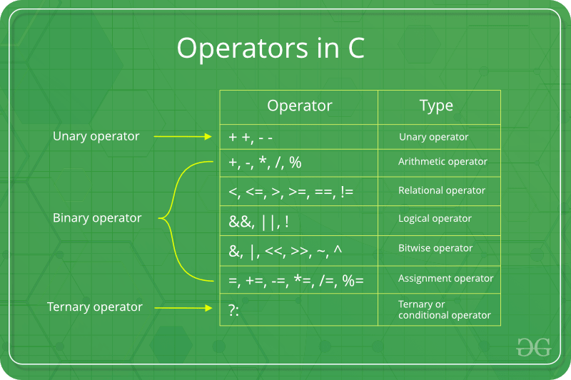
Operators in C

Slide 18
Operators in C
Arithmetic Operators (+, -, *, /, %, post-increment, pre-increment, post-decrement, pre-decrement) +
Relational Operators (==, !=, >, <, >= & <=) Logical Operators (&&, || and !)
Bitwise Operators (&, |, ^, ~, >> and <<)
Assignment Operators (=, +=, -=, *=, etc)
Other Operators (conditional, comma, sizeof, address, redirection)

Slide 19
Comments in C
Comments in C language are used to provide information about lines of code. It is widely used for documenting code. There are 2 types of comments in the C language.
Single Line Comments \\
Multi-Line Comments\*-----------
Single Line Comments
Single line comments are represented by double slash \\. Let's see an example of a single line comment in C.

Slide 20
Escape Sequence in C
An escape sequence in C language is a sequence of characters that doesn't represent itself when used inside string literal or character.
Character Combination consisting of a backslash(\) followed by a letter. Or combination of digits is called escape sequence.
The backward slash is called the escape character because it makes Character following it escape from its original meaning and gives special meaning to it.

Slide 21
List of Escape Sequences in C
Escape Sequence | Meaning
\a | Alarm or Beep
\b | Backspace
\f | Form Feed
\n | New Line
\r | Carriage Return
\t | Tab (Horizontal)
\v | Vertical Tab
\\ | Backslash
\' | Single Quote
\" | Double Quote
\? | Question Mark
\nnn | octal number
\xhh | hexadecimal number
\0 | Null

Slide 22
Simple C Program:-
#include<stdio.h>
int main()
{
printf(“Hello World”);
return 0;
}

Slide 23
Simple C Program:-
Line 1: [ #include <stdio.h> ] In a C program, all lines that start with # are processed by a preprocessor which is a program invoked by the compiler. In a very basic term, the preprocessor takes a C program and produces another C program. The produced program has no lines starting with #, all such lines are processed by the preprocessor. In the above example, the preprocessor copies the preprocessed code of stdio.h to our file. The .h files are called header files in C. These header files generally contain declarations of functions. We need stdio.h for the function printf() used in the program.

Slide 24
Simple C Program:-
Line 2: [int main() ]
main() is called more or less at the beginning of the program's execution, and when main() ends, the runtime system shuts down the program. main() always returns an int, as shown below:
main() has a special feature: There's an implicit return 0; at the end.
Thus if the flow of control simply falls off the end of main(), the value 0 is implicitly returned to the operating system. Most operating systems interpret a return value of 0 to mean "program completed successfully."

Slide 25
Simple C Program:-
Line 3 and 6: [ { and } ] In C language, a pair of curly brackets define scope and are mainly used in functions and control statements like if, else, loops. All functions must start and end with curly brackets.
Line 4 :-printf() is a standard library function to print something on standard output. The semicolon at the end of printf indicates line termination. In C, a semicolon is always used to indicate end of a statement
Line 5 [ return 0; ] The return statement returns the value from main(). The returned value may be used by an operating system to know the termination status of your program. The value 0 typically means successful termination. .

Slide 26
Operator Precedence and Associativity in C
Operator precedence determines which operator is performed first in an expression with more than one operators with different precedence.
Operators Associativity is used when two operators of same precedence appear in an expression. Associativity can be either Left to Right or Right to Left. For example: ‘*’ and ‘/’ have same precedence and their associativity is Left to Right, so the expression “100 / 10 * 10” is treated as “(100 / 10) * 10”.

Slide 27
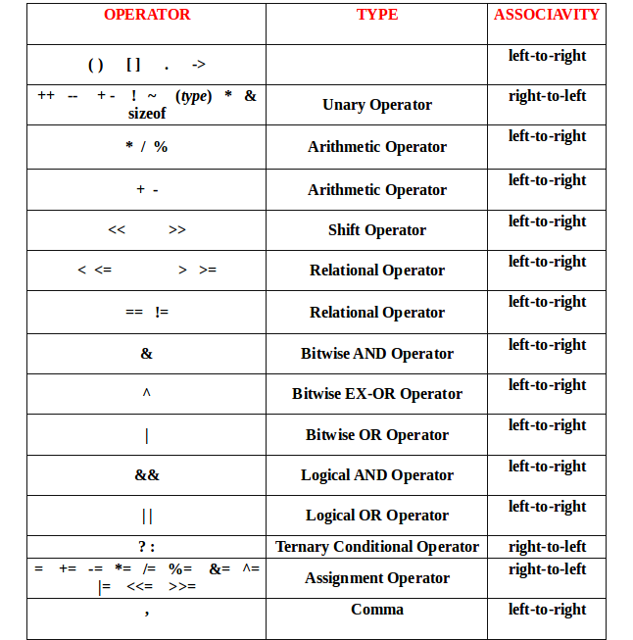
Operator Precedence and Associativity in C

